Slide 1
Is Singapore’s environmental conservation efforts enough?

Slide 2
Factors
01
02
03
Nitrous Oxide emissions
Total oil consumption
Usually produced by human activities such as agriculture and industrial processes.
Amount of oil used every single year.
Plastic per person
In kg/day, it shows how much plastic each person uses everyday.

Slide 3
World Data
World-oil | -units were in TWH(terawatt-hour) instead of KTOE(kilotonne of oil equivalent) so I had to convert it. -added a section called sector to merge
World-Plastic | -Set index as year, dropped column with country codes as it was mostly empty.
World-NO | -Includes Land Use change and forestry, which may have severely increased the total amount of nitrous oxide emitted.

Slide 4
SG Data
total-oil-consumpt-by-sector | -had values ‘-’, so had to replace with 0 as -added a section called sector to merge -all the values were above 1000, and it had commas, had to use pandas replace
SG-NO | -Nothing out of the ordinary
Generally, I used pandas to:
-Count null values using .isnull().sum()
-Check for unique values using pandas .nunique()
–Made the year the index columns to make it easier to merge, using pandas set_index.
-Dropped columns that had too many empty values.
-Found outliers and removed very extreme values, using IQR.

Slide 5
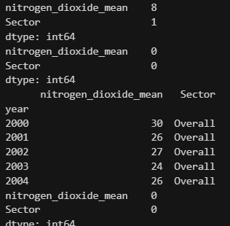
Data wrangling/Cleansing
Using SG-NO as an example, I cleansed the data by:
Checking for null values
Removing very far outliers
Saving it into a new dataset called SG-NO-CLEANSED.csv using pandas
I repeated these steps for all the datasets, and any extra steps such as replacing , in numbers > 1000 have already been stated.
By using the IQR of every dataset, I am also able to remove outliers that are a certain range above the upper bound. (This value is relative to the dataset)

Slide 6
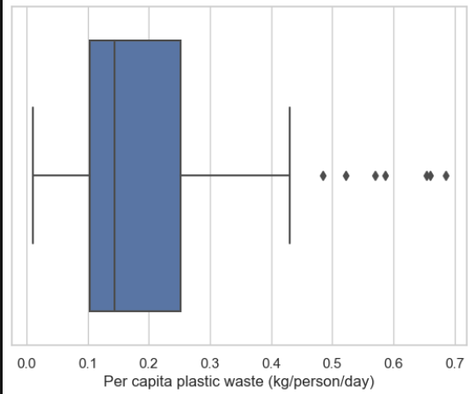
An example of a box plot plotted after cleansing the data.

Slide 7
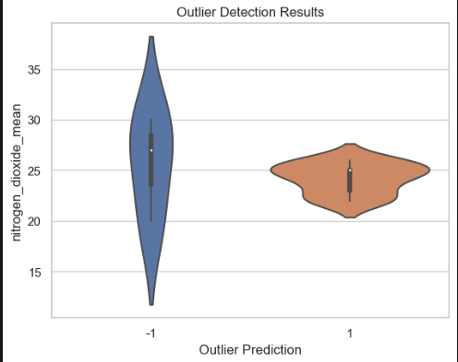
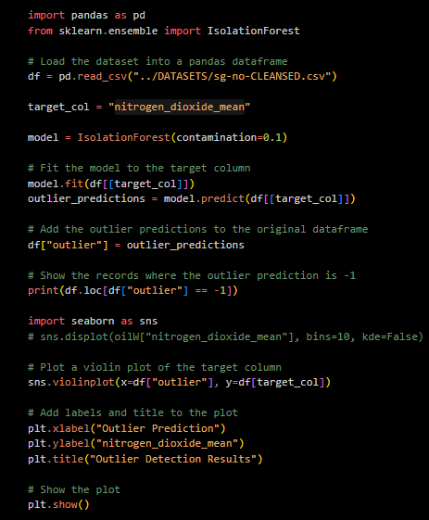
I also attempted using an sklearn module called isolationforest in order to find the outliers as an extra method in order to find the different outliers shown in the violin plot.

Slide 8
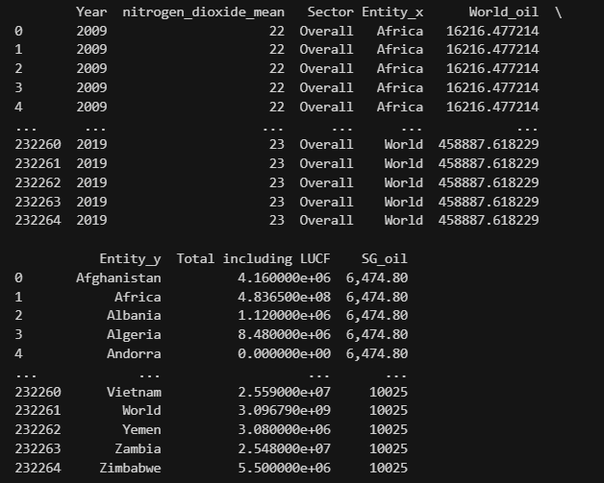
I also managed to combine all my datasets into one final dataset, which I constantly subsetted into smaller datasets in order for me to make it easier to plot.
By placing it all into one dataset, I did not need to refer to different dataframes in order to get the information and needed, and rather just indexed from the original dataset.
There were some discrepancies as first, but using wrangling and renaming columns using pandas rename column function, I was able to merge all the data using pandas merge via inner join with sectors and years.

Slide 9
01
Oil Consumption

Slide 10
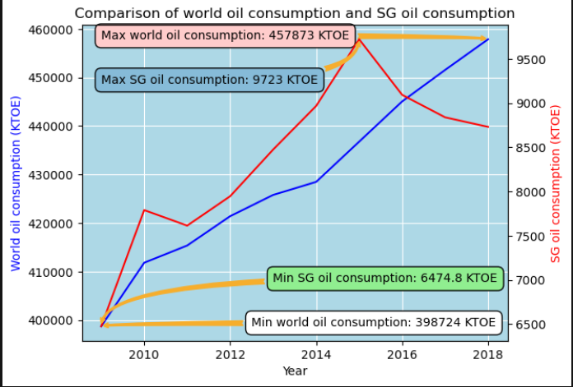
-I used a dual analysis in this graph to see if the trends in both the world and Singapore oil consumption.
-As we can see, the trend is generally the same, a spike in 2010, another in 2015 and a steep increase from 2012 to 2014. However, in 2016, our oil consumption began to dip, while the world oil consumption was still on the rise.
-Using matplotlib’s annotation functions, we can see the different critical values of oil consumption such as the lowest and peak.
-We can conclude that Singapore is successful in being environmentally friendly as our oil consumption is lowering while it is increasing in other parts of the world.

Slide 11
02
Nitrous Oxide emissions

Slide 12
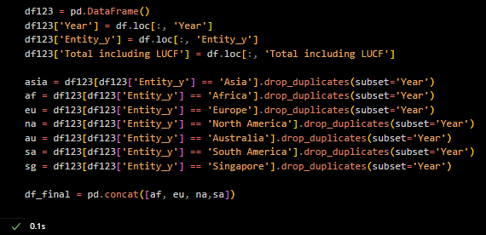
In this factor, I tried making a sub dataset containing all the different continents that I would like to plot against Singapore in order to maximise the dataset that I was given. By matching the continent names to the names in the dataset, I was able to fetch the data from 2009-2019, which I used to catplot (showing the distribution of data) and regplot (showing the change/trends in the data). The confidence interval allowed me to see if the data would fall between the predicted values.

Slide 13
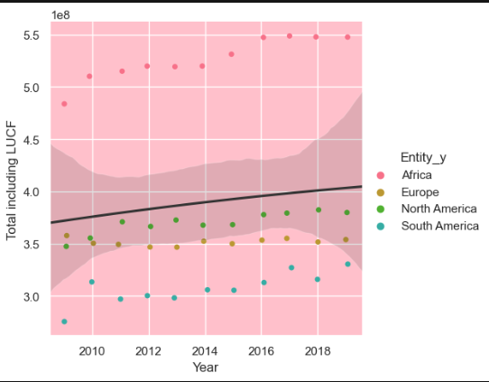
-Firstly, I would like to find out the increase in Nitrous Oxide emissions by other regions apart from Asia, and find out the average change in emissions.
-The shaded area represents the 95% confidence interval, providing a range of plausible values for the population parameter.
-As we can see from the regression, the line is showing a slight increase from about 3.7 to 4.05x10^8 tonnes of emission. Hence, there is about an average of 0.45 increase in oil consumption across the globe.
-We can also see that Africa has the highest nitrous oxide emissions as a region.

Slide 14
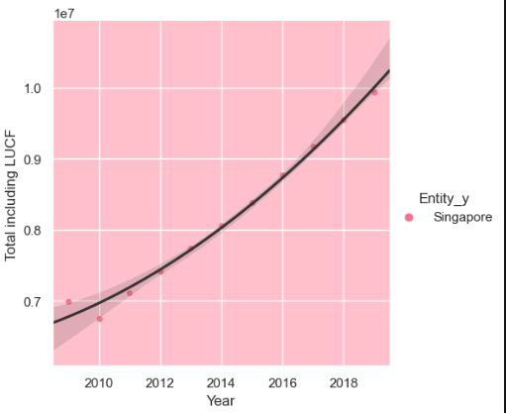
Next, looking at Singapore, we can see a similar increase in the total emission, albeit quadratic instead of linear.
This shows that the increase in emissions may increase even more over the years, which may boost the amount of nitrous oxide produced in a year.
Hence, even though the increase from 2009 to 2019 is only 0.45, as it is showing signs of an increasing gradient, we can conclude that the environmental efforts in lowering nitrous oxide emissions is not sufficient.

Slide 15
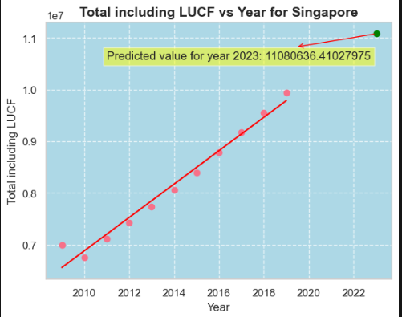
To prove my point, I used simple linear regression, set year as the independent variable and Total emission as the dependent variable, and tried to predict the next value.
As we can see, it rounds off to about
1.11 billion tonnes in 2023, which is a whole 1 billion tonne increase from 2019.
The graph also shows how the point is slightly higher than the line original line if it was extended, which shows that the increase in total emissions in a year is increasing.
Hence, we can tell that the efforts to lower nitrous oxide emission in Singapore can be improved.

Slide 16
03
Plastic per person

Slide 17
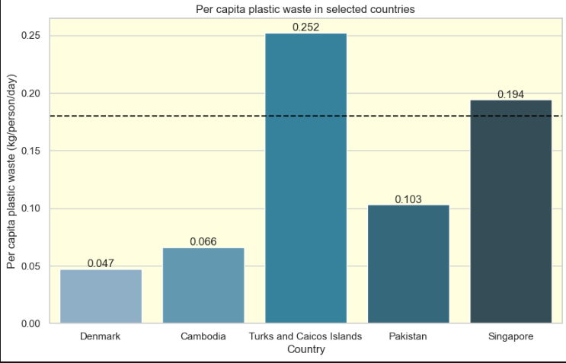
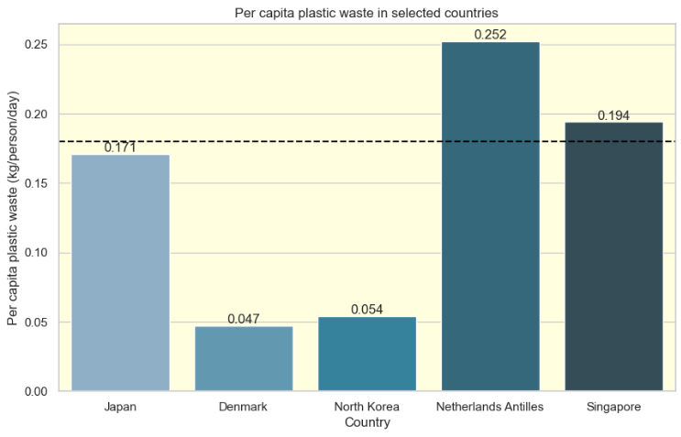
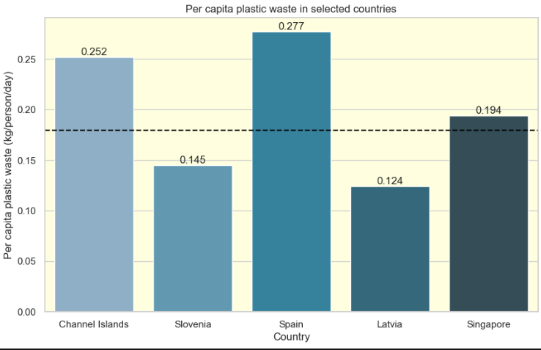
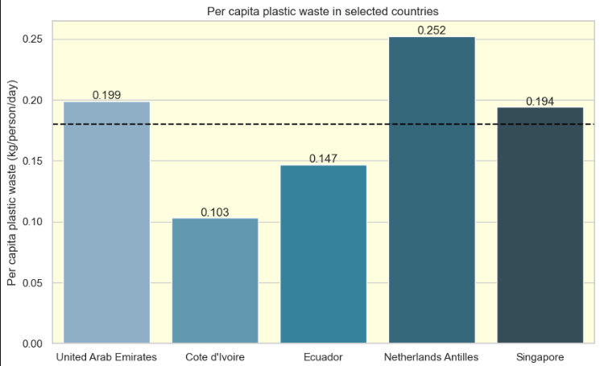

Slide 18
-In this analysis, I randomise 4 different countries to see against Singapore. By randomising, we can get a randomised sample from all the countries.
-From the graphs, we can see that Singapore is generally near average to above average in plastic usage, with a value of 0.194kg, which is above the overall average of all countries in the dataset.
-From that, we can infer that the plastic usage is Singapore is average compared to other countries, but barely sufficient.
-Hence, Singapore has done enough to conserve the environment by managing plastic usage
*note that this was last recorded in 2010, because there werent any datasets that were more recent.

Slide 19
Conclusion

Slide 20
-To conclude, Singapore has done (just barely,) enough to conserve the environment, relative to other countries.
-From this assignment, through placing my focus more on the data wrangling and cleansing side of pandas, I have learnt the importance of managing my data through using the different functions offered by pandas.
-Furthermore, through finding more insights, I have also learnt how to be more efficient in using seaborn and matplotlib in order to plot.
-I hope you have benefitted from my presentation, thank you for listening!

Slide 21
List of references
https://ourworldindata.org/atmospheric-concentrations
https://ourworldindata.org/plastic-pollution
https://data.gov.sg/dataset/air-pollutant-nitrogen-dioxide
https://data.gov.sg/dataset/total-oil-consumption-by-sector

Slide 22
Thanks
Do you have any questions?
your email@freepik.com
+91 620 421 838 yourcompany.com
Please keep this slide for attribution

